Slide 1
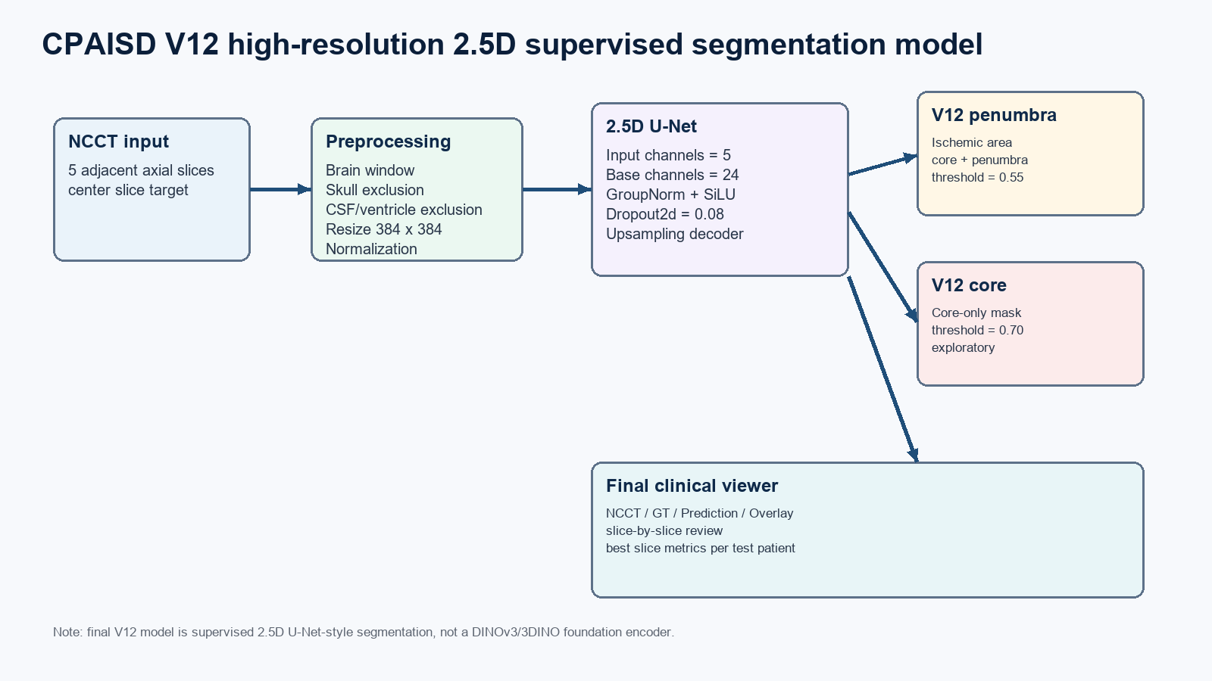
CPAISD V12 Final Report
High-resolution 2.5D supervised NCCT segmentation for ischemic area (core + penumbra)

Slide 2
Final test performance
Primary endpoint is V12_penumbra; V12_core is exploratory
V12_penumbra Dice
IoU
Precision
Recall
Threshold
0.4217
0.2672
0.5505
0.3418
0.55
V12_core test Dice = 0.0701 at threshold 0.70. Core-only performance is reported as exploratory because held-out generalization was weak.
Clinical interpretation: the final model should be framed as full ischemic-area segmentation rather than reliable core-only quantification.
CPAISD V12 final model | 2.5D supervised NCCT segmentation

Slide 3
Model architecture and preprocessing
2.5D supervised U-Net-style model, not a final DINOv3/3DINO encoder result
CPAISD V12 final model | 2.5D supervised NCCT segmentation

Slide 4
Training parameters
The same V12 setting was used for penumbra/ischemic-area and core-only targets
Input | 5 adjacent axial NCCT slices; center slice output
Resolution | 384 x 384
Model | 2.5D U-Net, base channels 24, Dropout2d 0.08
Training | 5-fold, 35 epochs, batch size 2, early stopping patience 7
Optimizer | AdamW, lr 0.0001, weight decay 0.0005
Loss balance | Tversky alpha/beta 0.75/0.25; BCE pos weight 2.0
HU tissue gate | 18.0 to 90.0 HU
Augmentation | rotation +/-7.0 deg; scale 0.94-1.06
CPAISD V12 final model | 2.5D supervised NCCT segmentation

Slide 5
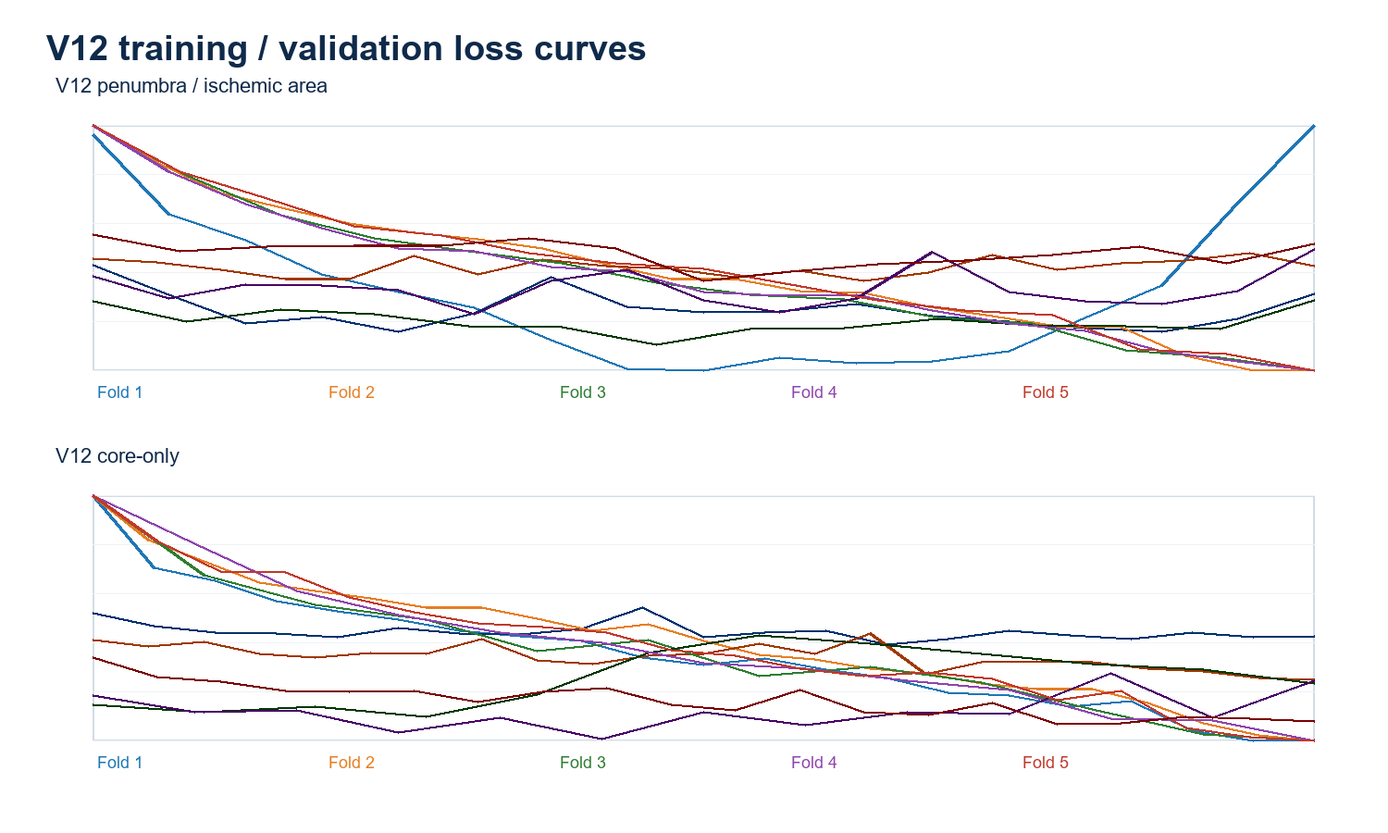
5-fold validation and overfitting check
Loss curves and validation Dice support V12 selection
Mean best validation Dice: V12_penumbra 0.3715; V12_core 0.2753.
CPAISD V12 final model | 2.5D supervised NCCT segmentation

Slide 6
Viewer and deliverables
Final deployment focuses on V12 outputs
Cloudflare Pages
https://32c21435.cpaisd-v11-v12-viewers.pages.dev
Viewer entries
V12_penumbra: NCCT / GT / Prediction / Overlay
V12_core: core-only auxiliary viewer
V12 combined: same patient and slice, both outputs together
Recommended reporting language
Use V12_penumbra as the final model. Present V12_core as a separate exploratory analysis and avoid claiming reliable core quantification on the held-out test set.
CPAISD V12 final model | 2.5D supervised NCCT segmentation

